Slide 1



Code Exchange™
Sprint review Duo A
Korte presentatie en live demo
Code Exchange © | copyright 1643- 2027 Burnout Alliance ™ All rights reserved

Slide 2

● Sprint bord Sprint 4 ● TMC-cyclus met resultaat ● Commit geschiedenis ● Sprint bord Sprint 5 ● Demo
Inhoudsopgave
Code Exchange © | copyright 1643- 2027 Burnout Alliance ™ All rights reserved

Slide 3
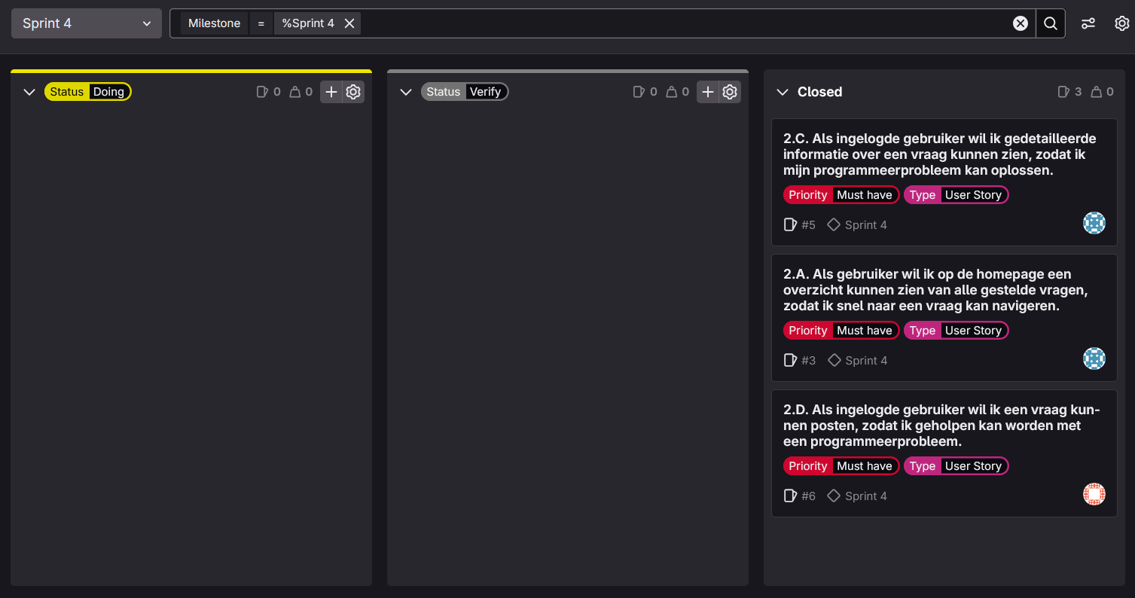
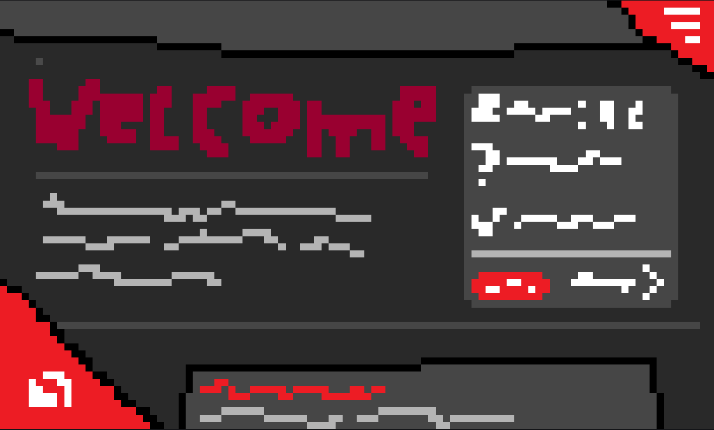
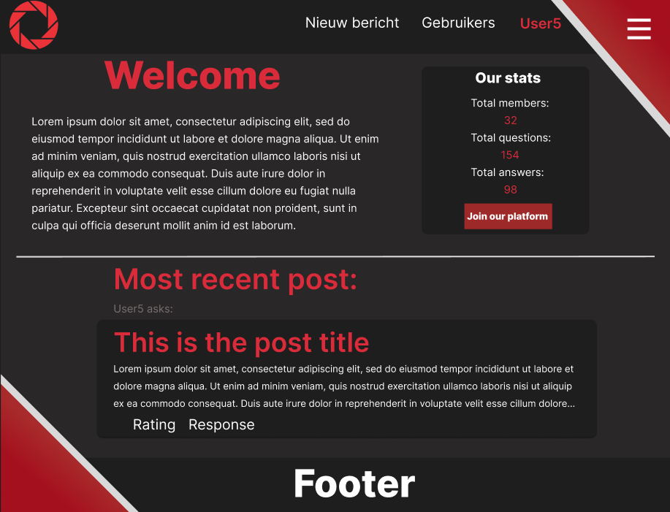
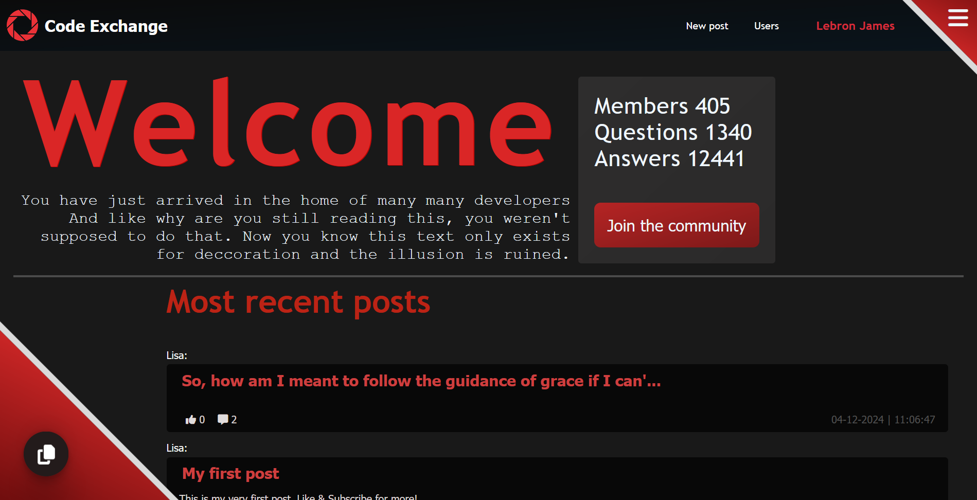
TMC-cyclus
Sprint bord Sprint 4
Code Exchange © | copyright 1643- 2027 Burnout Alliance ™ All rights reserved

Slide 4

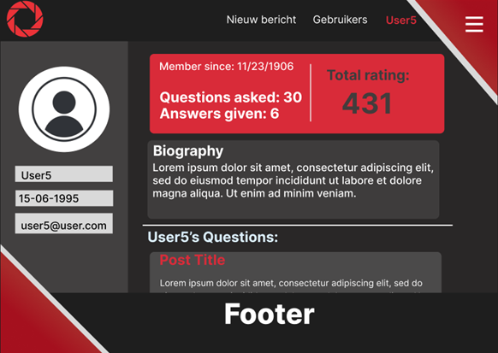
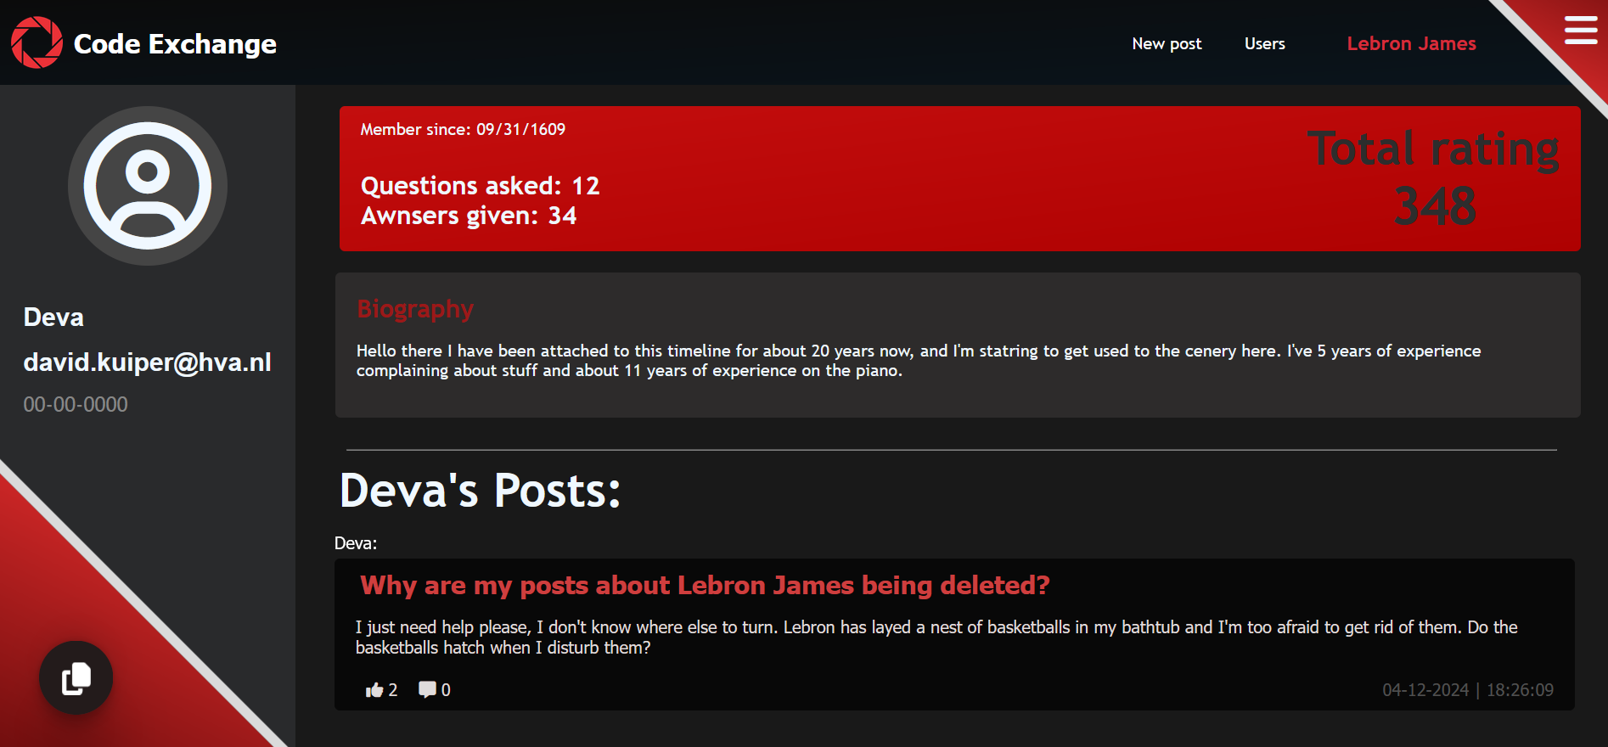
ada
TMC-cyclus
TMC-cyclus
Home Pagina
Code Exchange © | copyright 1643- 2027 Burnout Alliance ™ All rights reserved

Slide 5
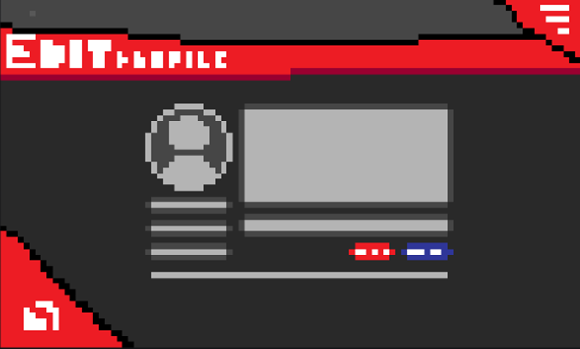
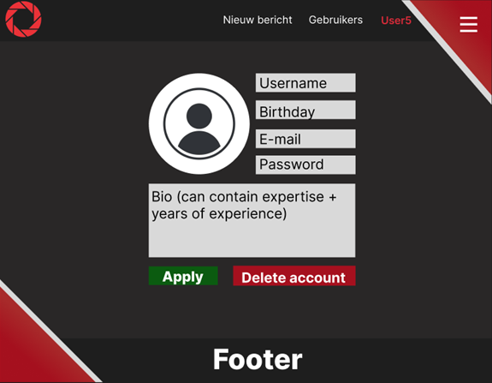

ada
TMC-cyclus
TMC-cyclus
Profiel Pagina
Code Exchange © | copyright 1643- 2027 Burnout Alliance ™ All rights reserved

Slide 6
ada
TMC-cyclus
TMC-cyclus
Profiel wijzigen
Code Exchange © | copyright 1643- 2027 Burnout Alliance ™ All rights reserved

Slide 7
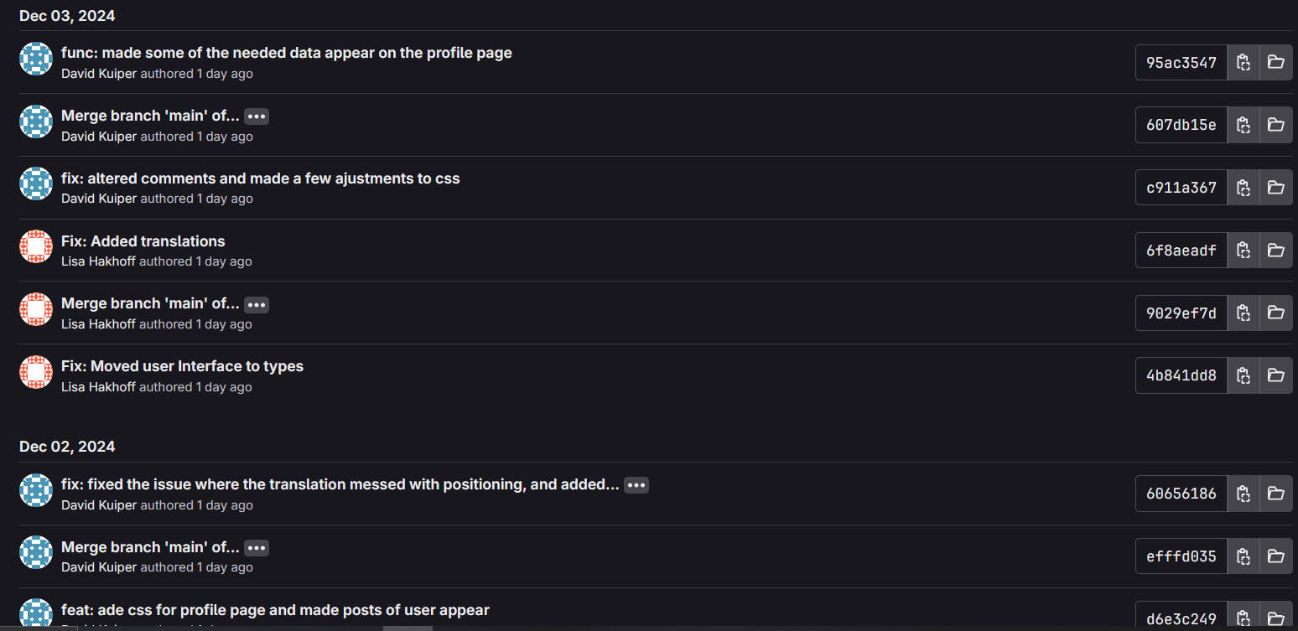
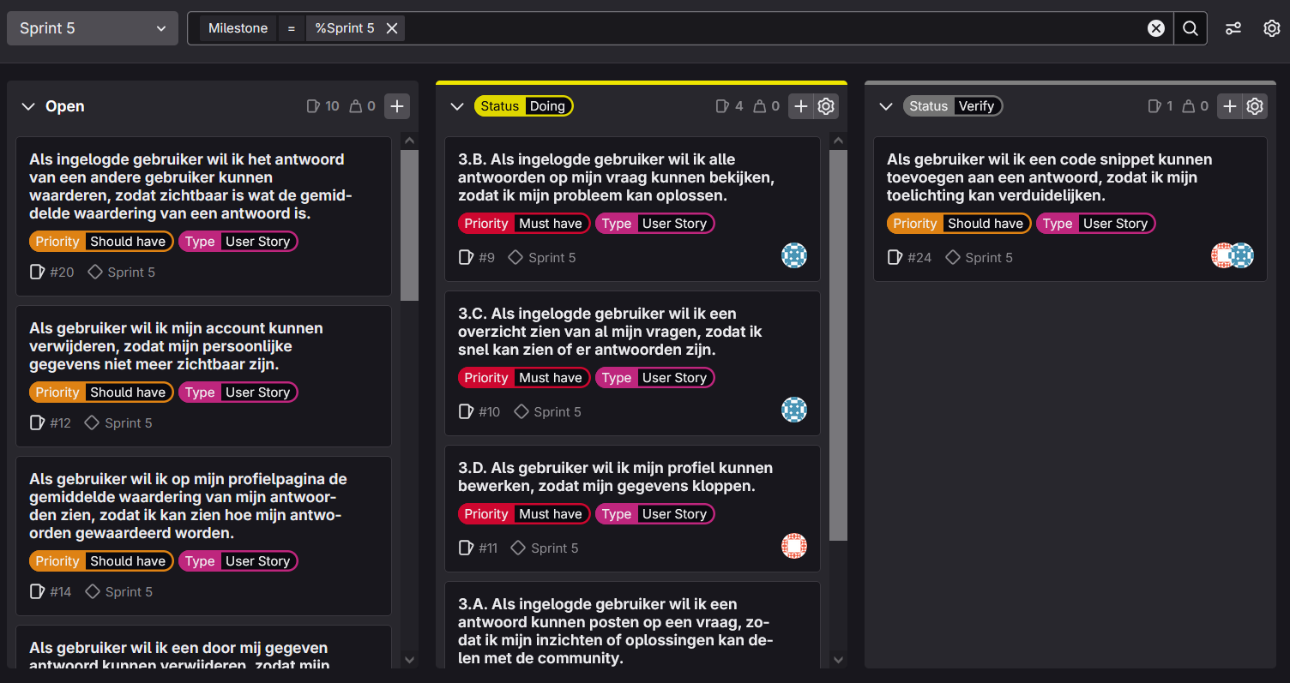
TMC-cyclus
Commit geschiedenis
Sprintbord sprint 5
Code Exchange © | copyright 1643- 2027 Burnout Alliance ™ All rights reserved

Slide 8
Minimaal Levensvatbaar Product
Sprintbord sprint 5
Commit geschiedenis
Code Exchange © | copyright 1643- 2027 Burnout Alliance ™ All rights reserved

Slide 9
Live demonstratie
Minimaal Levensvatbaar Product
& Feedback
Code Exchange © | copyright 1643- 2027 Burnout Alliance ™ All rights reserved
Hallo allemaal! ヾ(＾ ∇ ＾).

Slide 10
Dit hoor jij niet te zien
Minimaal Levensvatbaar Product
Code Exchange™
Bedankt voor uw aandacht
Code Exchange © | copyright 1643- 2027 Burnout Alliance ™ All rights reserved

